Slide 1



Project Presentation
Dandi Wibowo
as Talent
In BCA x Arkademy
Notes:
Sebelum melangkah lebih jauh tentang internship saya, saya ingin memperkenalkan diri saya, nama saya Dandi Wibowo, saya lulusan dari kampus ITS Surabaya Jurusan Teknik Komputer. dan saya mengawali perjalanan karir saya dengan mengikuti Internship program di multinational company, yaitu Schlumberger.

Slide 2
What we will do ?
What is GIT
My Project

Slide 3
What is GIT ?
Git is a distributed version-control system for tracking changes in source code during software development. It is designed for coordinating work among programmers, but it can be used to track changes in any set of files. Its goals include speed, data integrity.

Slide 4
GIT Basic Command
git init
Create a new local repository
git clone /url
Create a working copy of a local repository
git status
List the files you've changed and those you still need to add or commit
git add
Add one or more files to staging
git commit
Commit changes to head (but not yet to the remote repository)
git push
Send changes to the master branch of your remote repository
git pull
Fetch and merge changes on the remote server to your working directory
https://confluence.atlassian.com/bitbucketserver/basic-git-commands-776639767.html

Slide 5
My Project

Slide 6

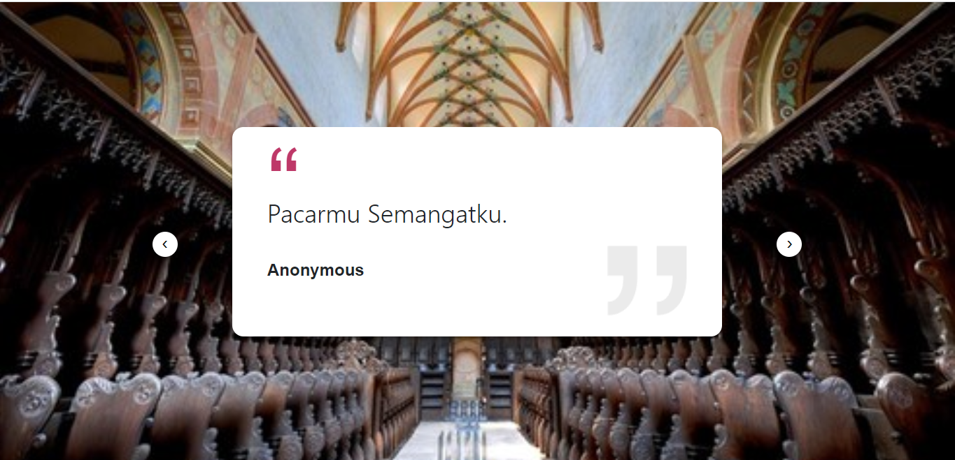
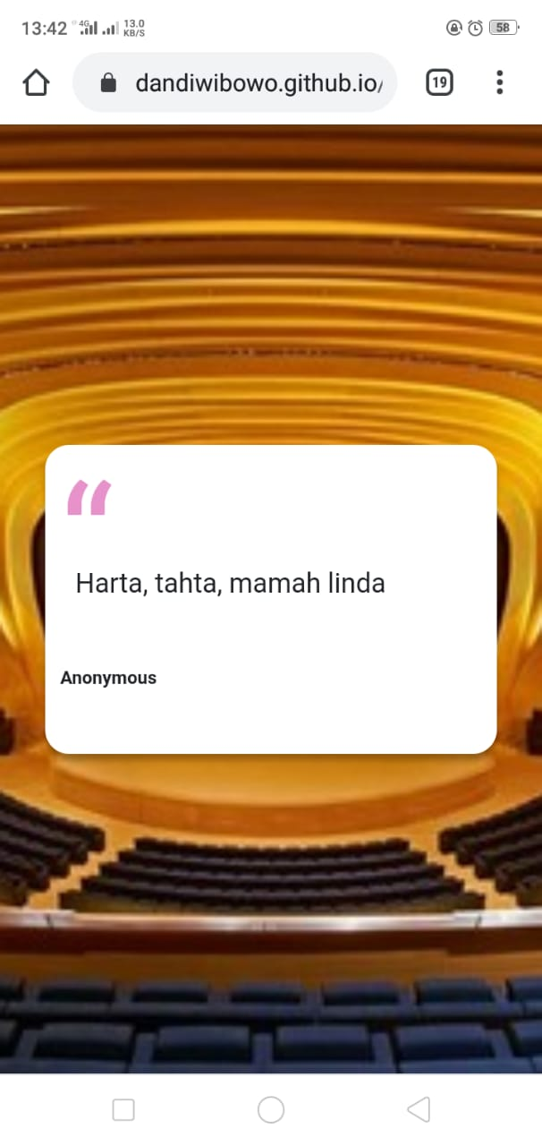

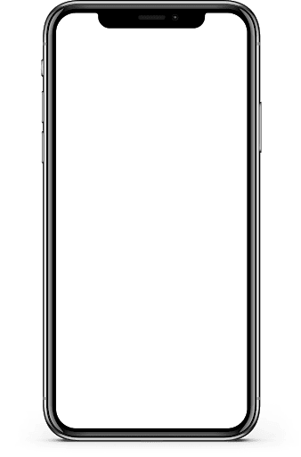
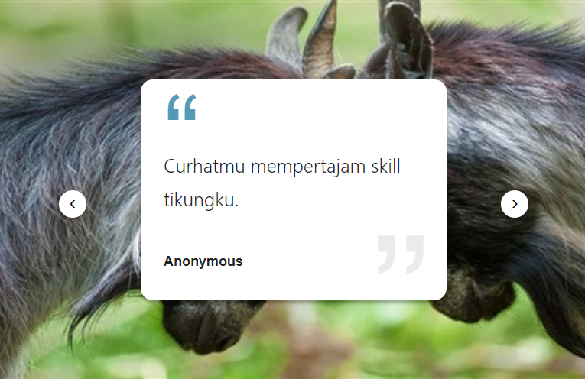
Daily Quotes

Slide 7



My Project
JavaScript
HTML
CSS

Slide 8
My Project Flow
Start
Store data to Array;
Counter = 0;
Call API
Error?
NO
Display Data
YES
Display Error
End ?
NO
Prev button klicked?
YES
Decrease Counter
YES
NO
Next button klicked?
YES
Increase Counter
End
NO

Slide 9
Show Codes

Slide 10


My Project Published on :
Github
Netlify

Slide 11
Thankyou

